Slide 1
JavaBean Concepts
  A software component is a reusable object that can be plugged into any target software application.
  You can develop software components using various programming languages, such as C, C++, Java, and Visual Basic.
  JavaBeans are reusable and platform-independent software components developed using the Java programming language.
  The classes and interfaces defined in the java.beans package enable you to create JavaBeans.
  The JavaBean components can exist in one of the following three phases of development:
    Construction phase
    Build phase
    Execution phase

Slide 2
JavaBean Concepts (Contd.)
  Elements of a JavaBean
    Properties: Refer to the private data members of a JavaBean that define the behavior of the JavaBeans.
    Methods: Refer to public member functions of a JavaBean that are used to modify the JavaBean properties.
    Events: Refer to the messages that one JavaBean components sends to another JavaBean components.

Slide 3
JavaBean Concepts (Contd.)
  The JavaBean Component Specification
    Customization: Is the ability of JavaBean to allow its properties to be changed in build and execution phase.
    Persistence: Is the ability of JavaBean to save its state to disk or storage device and restore the saved state when the JavaBean is reloaded.
    Communication: Is the ability of JavaBean to notify change in its properties to other JavaBeans or the container.
    Introspection: Is the ability of a JavaBean to allow an external application to query the properties, methods, and events supported by it.

Slide 4
JavaBean Concepts (Contd.)
  Services of JavaBean Components
    Builder support: Enables you to create and group multiple JavaBeans in an application.
    Layout: Allows multiple JavaBeans to be arranged in a development environment.
    Interface publishing: Enables multiple JavaBeans in an application to communicate with each other.
    Event handling: Refers to firing and handling of events associated with a JavaBean.
    Persistence: Enables you to save the last state of JavaBean.

Slide 5
JavaBean Concepts (Contd.)
  Types of JavaBeans
    Control JavaBeans: Are used to create GUI components that can be plugged into any application.
    Container JavaBeans: Are used to hold other JavaBeans.
    Invisible Runtime JavaBeans: Are used to create components that perform a specific task in the background of an application.

Slide 6
Beans Development Kit
  Is a development environment to create, configure, and test JavaBeans.
  The features of BDK environment are:
    Provides a GUI to create, configure, and test JavaBeans.
    Enables you to modify JavaBean properties and link multiple JavaBeans in an application using BDK.
    Provides a set of sample JavaBeans.
    Enables you to associate pre-defined events with sample JavaBeans.

Slide 7
Beans Development Kit (Contd.)
  Identifying BDK Components
    Execute the run.bat file of BDK to start the BDK development environment.
    The components of BDK development environment are:
      ToolBox
      BeanBox
      Properties
      Method Tracer

Slide 8
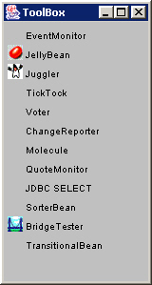
Beans Development Kit (Contd.)
    ToolBox window: Lists the sample JavaBeans of BDK.
    The following figure shows the ToolBox window:

Slide 9
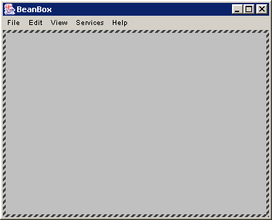
Beans Development Kit (Contd.)
    BeanBox window: Is a workspace for creating the layout of JavaBean application.
    The following figure shows the BeanBox window:

Slide 10
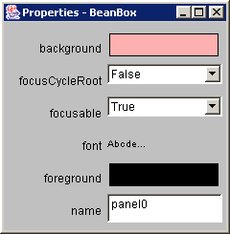
Beans Development Kit (Contd.)
    Properties window: Displays all the exposed properties of a JavaBean. You can modify JavaBean properties in the properties window.
    The following figure shows the Properties window:

Slide 11
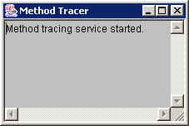
Beans Development Kit (Contd.)
    Method Tracer window: Displays the debugging messages and method calls for a JavaBean application.
    The following figure shows the Method Tracer window:

Slide 12
Demonstration-Creating Sample JavaBean Applet using BDK
  Problem Statement
    Create an applet that shows the sample Molecule JavaBean rotating along its X-axis.

Slide 13
Demonstration-Creating Sample JavaBean Applet using BDK (Contd.)
  Solution
    To create an applet that shows a Molecule JavaBean rotating along its X-axis, you need to perform the following tasks:
      Associating pre-defined event with sample JavaBeans.
      Converting the JavaBean to an applet.

Slide 14
User-Defined JavaBean
  The coding conventions to create a user-defined JavaBean are:
    Implement the java.io.Serializable interface.
    Define an empty constructor to initialize the instances of a JavaBean.
    Define the accessor and mutator methods for the exposed properties of a JavaBean.

Slide 15
User-Defined JavaBean (Contd.)
  Accessor and Mutator Methods:
    Are used to access the exposed properties of a JavaBean.
    The accessor methods:
      Are used to retrieve the values of JavaBean properties.
      Are also called get methods.
    The mutator methods:
      Are used to specify the values of JavaBean properties.
      Are also called set methods.

Slide 16
User-Defined JavaBean (Contd.)
  Manifest and JAR Files
    Manifest File
      The manifest file for a JavaBean application contains a list of all the class files that make up a JavaBean.
      The entry in the manifest file enables the target application to recognize the JavaBean classes for an application.
      For example, the entry for the SpellCheck JavaBean in the manifest file is as shown:
      Name: SpellCheck.class
      Java-Bean: True

Slide 17
User-Defined JavaBean (Contd.)
    Manifest File (Contd.)
      The rules to create a manifest file are:
        Press the Enter key after typing each line in the manifest file.
        Leave a space after the colon.
        Type a hyphen between Java and Bean.
        No blank line between the Name and the Java-Bean entry.

Slide 18
User-Defined JavaBean (Contd.)
    Java Archive File
      The files of a JavaBean application are compressed and grouped as JAR files to reduce the size and the download time of the files.
      The syntax to create a JAR file from the command prompt is:
      jar <options> <file_names>
      The file_names is a list of files for a JavaBean application that are stored in the JAR file.

Slide 19
User-Defined JavaBean (Contd.)
    Java Archive File (Contd.)
      The various options that you can specify while creating a JAR file are:
        c: Indicates the new JAR file is created.
        f: Indicates that the first file in the file_names list is the name of the JAR file.
        m: Indicates that the second file in the file_names list is the name of the manifest file.
        t: Indicates that all the files and resources in the JAR file are to be displayed in a tabular format.
        v: Indicates that the JAR file should generate a verbose output.
        x: Indicates that the files and resources of a JAR file are to be extracted.
        o: Indicates that the JAR file should not be compressed.
        m: Indicates that the manifest file is not created.

Slide 20
Demonstration-Creating User-Defined JavaBean
  Problem Statement
    Create a user-defined JavaBean having a label. Allow the user to change the caption of the user-defined JavaBean at runtime.

Slide 21
Demonstration-Creating User-Defined JavaBean (Contd.)
  Solution
    To create a user-defined JavaBean that changes the caption of a label, you need to perform the following tasks:
      Code the user-defined JavaBean
      Package the JavaBean
      Load and test the JavaBean

